Slide 1
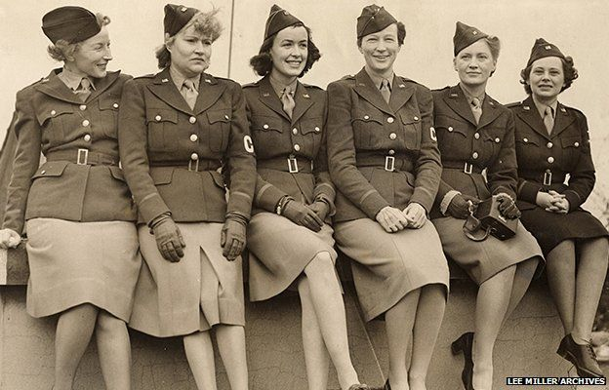
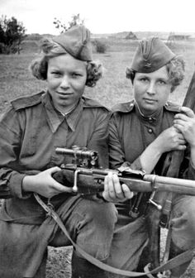
THE Women in the Second World War Museum
Desseya, Ben, & Tia

Slide 2
Our Map
A – Yellow Room – Pilots and Secretaries
B – Orange Room – Women’s Job Status
C – Red Room – Women’s Family Roles
D – Green Room – Women’s roles Before and After WW2
E – Black Room – War contributions of Women on Homefront
F – Blue Room – War Experience of European Women
G – Purple Room – Healthcare and supplies as Women’s contribution
H – Pink Room – Nursing as a military contribution of Women
I – White Room – Victory Gardens and Victory Bonds on the Homefront
J – Gold Room – Gift Shop ☺
K – Silver Room – War Experience of Asian Women

Slide 3
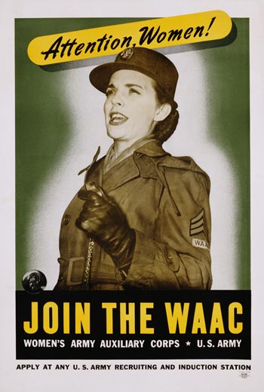
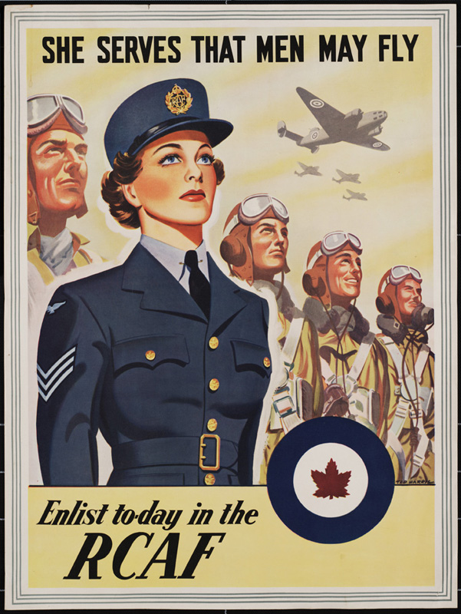
Yellow Room (A) – Pilots and Secretaries [On the Homefront.]
The Women Airforce Service Pilots (WASP), were women pilot flew cross-state mission to ferry planes when male pilots were in short supply. In September 1942, General Henry H. Arnold agreed to form two units of women who would help fly aircraft in the United States. They were The Women's Auxiliary Ferry Squadron (WAFS), led by Nancy Harkness Love and The Women's Flying Training Detachment (WFTD), led by Jackie Cochran. These two groups united in 1943 to create WASP. They were the first women to fly American military aircraft. There were over 1,074 trained WASP pilots who flew from 126 bases in the United States and carried fifty percent of the combat aircraft during the war. Thirty-Eight of these women died in service. The WASP was disbanded in 1944 when the number of male pilot was enough. The WASP was granted veteran status in 1977, and given the Congressional Gold Medal in 2009.
Women also served as spies in the Office of Strategic Services, a United States intelligence agency, during World War II. Woman made up 4,500 of the 13,000 employees of OSS. Some of these jobs included clerk, operation agents, code-breakers, and undercover agents. Among the 4,500 women workers, 1,500 of them worked overseas. A woman named Claire Phillips from Portland, Oregon, served as a spy in the Philippines without any training. She ran a spy ring out of Club Tsubaki, a cabaret in Manila that was popular with Japanese officers. She would also funnel food, medicine, and other supplies to prisoners in Manila. However, two of the most notorious agents were Elizabeth Thorp Pack and Virginia Hall. Elizabeth would entice male officers to gain intelligence. She was most known for helping to steal the first enigma machine form Polish intelligence and in securing Italian and Vichy French codebooks. Virginia was most known for disguising herself as a milkmaid in France. There she would report all enemy movements against Hitler and his forces. She was one of the most wanted people in Germany and the Gestapo named her to be "the most dangerous of all alien spies".

Slide 4
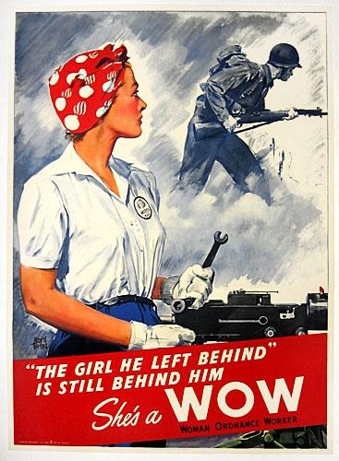
Orange Room (B) - Women’s Job Status in the Americas
World War II was a time when women were desperately needed. Women had to take jobs that were traditionally for men. Also there were various advertisements that were used to encourage women to take these roles and jobs. Women served at home and abroad. Women worked as nurses and in factories. It was during WWII when women were accepted and wanted in the military so women served as air force service pilots

Slide 5
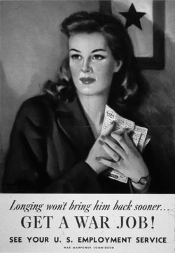
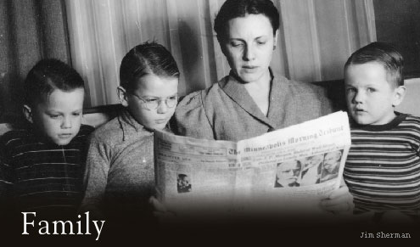
Red Room (C) – Impact of War on Women’s Family Roles
Women needed to work in the factories for the war effort to produce ammunitions. Women filed in roles for the men, just the single ladies at first, but later married women. As a result, the strictly house-maker role of women was expanded upon to include special branches of the military, as well as factory jobs. In the meanwhile, in Canada, childcare was an incentive for women to join the work force. The government lent its hand in caring for the children of working mothers, and children were given a degree of independence and responsibility as the other children had to care for themselves and their siblings.

Slide 6
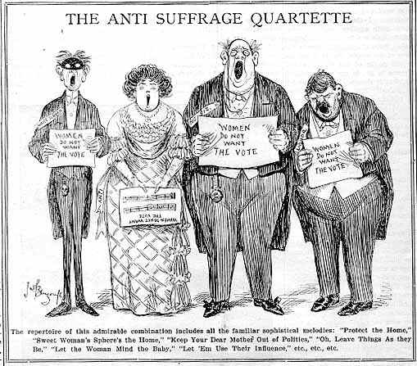
Green Room (D) – Women’s roles Before & After the War
Before the Second World War, bereaved women had been allowed to vote for the men in their lives who went to serve, whether a husband, brother, or otherwise. In 1921 7% of women were in the work force. The 1929 PERSONS CASE amended the laws of the time so that women were also considered persons under the Law. During the Second World War, all Canada at the time achieves country wide woman suffrage (Quebec was lagging behind everyone else). After the war the suffragettes banded together, Feminism cropped up, and by 1971 39% of women were in the work force.

Slide 7
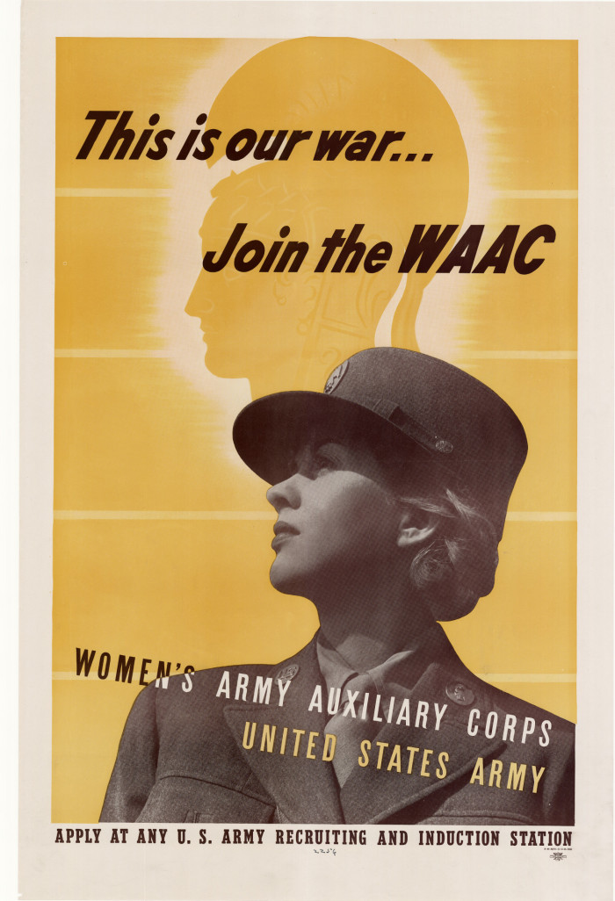
Black Room (E) – War contributions of Women on the Homefront
During WWII, about 350,000 U.S. women served in Arm Forces. 60,000 of them served as nurse in all militaries but the U.S. decided not to use women in combat because public opinion would not tolerate it. In 1942, The Army established the Women's Army Auxiliary Corps (WAAC) which then was converted to the Women's Army Corps (WAC) in 1943. More than 150,000 women served in this group. Women became officially recognized as a permanent part of the U.S. armed forces after the war, with the passing of the Women's Armed Services Integration Act of 1948.

Slide 8
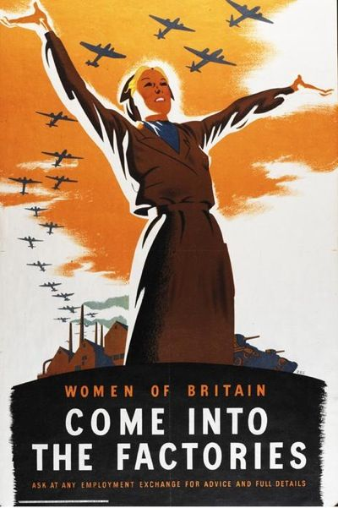
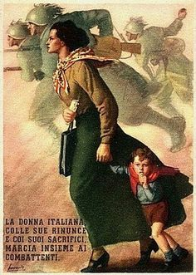
The Blue Room (F) – Special Display: War Experience of European Women
In Britain, women were encouraged to join war production.
In Russia, women were trained as combat pilots. 4,419 combat missions. 125 air battles. 38 women killed. One pilot example: Lydia LitvyakIn Fascist Italy, women were forced out of the work force meanwhile abortion, family allocations, maternity, and birth and marriage insurances were banned. Mother’s day was established to reinforce childbearing as an honorable service to the state.
In Fascist Germany, women were confined to the roles of mother and spouse. They were pushed out of the professional sphere. Few exceptions were found, though a handful of highly skilled women were allowed to maintain their roles. A German Mother’s day was also established.
In Soviet Russia, Marina Raskova, famous aviator, had personal connections to Joseph Stalin. Russia was the first nation to allow women pilots to fly combat missions. Soviet women were also snipers and many were partisans.

Slide 9
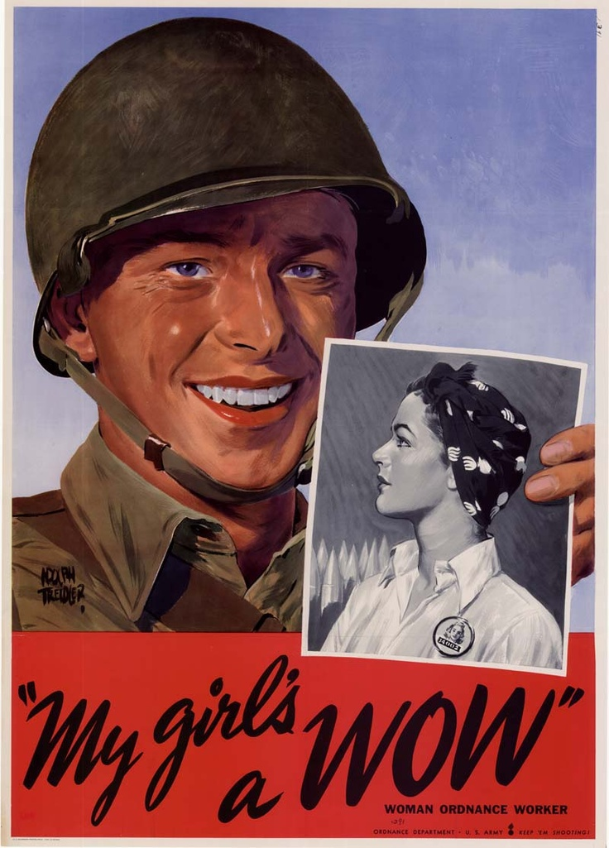
Purple Room (G) – Healthcare and Supplies as a contribution of Women on the Homefront
During WWII society continued to engage in its various public health activities at home, but for the duration of the war the society’s primary focus changed so that they were providing aid to sick, wounded and captured troops. The society also provided health care for civilians that were effected by the war. Canadians donated millions of dollars for health care supplies and volunteered many hours. Therefore Canadians were very generous.

Slide 10
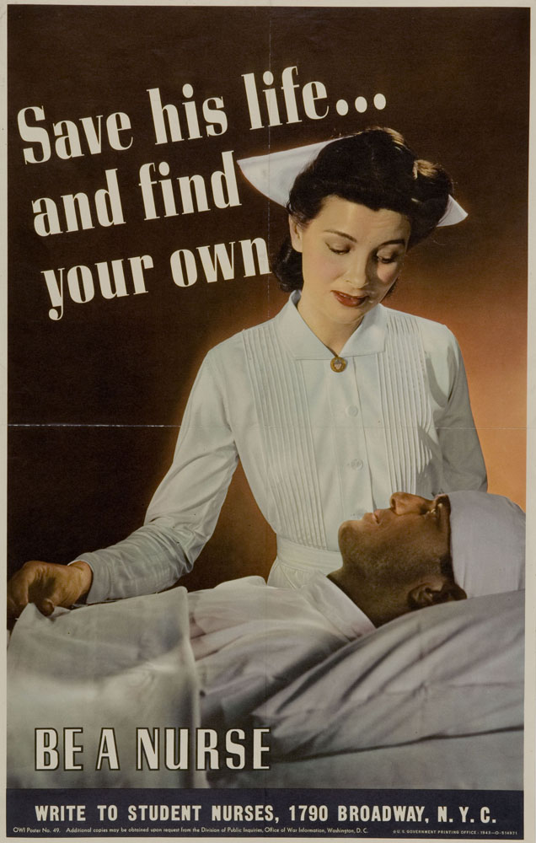
Pink Room (H) – Nursing as a military contribution of Women
Women during the time of World War II played a large role in supporting the military. Due to the large need of support America was facing, many new social and economic opportunities opened up for women. Nursing was high in demand and an urgent need and the women were quick to respond. More then 59,000 American women become nurses. Due to the great need for nurses, the government provided free education between the years of 1943 to 1948. Furthermore, nurses had to work closer to the front lines than ever before and they risked their own lives daily. They had to work on land, sea and air. As the only people there to help the wounded soldiers they had to deal with every injury that occurred. Nurses attended to over 100 soldiers a day and would insist to not leave their side. It was also not uncommon for nurses to work up to 84 hours a week. Although it may have been incredibly difficult, enemy camps were set up and nurses had to attend to them, therefore they had to swallow their pride. Nurses got sent all over the world and were commonly trained in Canada. Canada’s nurses were all women between the ages of 21 and 38. Most of the nurses had family members like their fathers or a brother serving in the war. The Canadian group of women nurses called the "nursing sisters" was sent to Britain to care for wounded soldiers. During WW2, women operated in the army, the navy, and the air force. Medical units followed the front lines through Europe, and many casualties were handled by these women. These nurses were very dedicated to contributing to the war, and played a very important role in the war effort in World War 2.

Slide 11
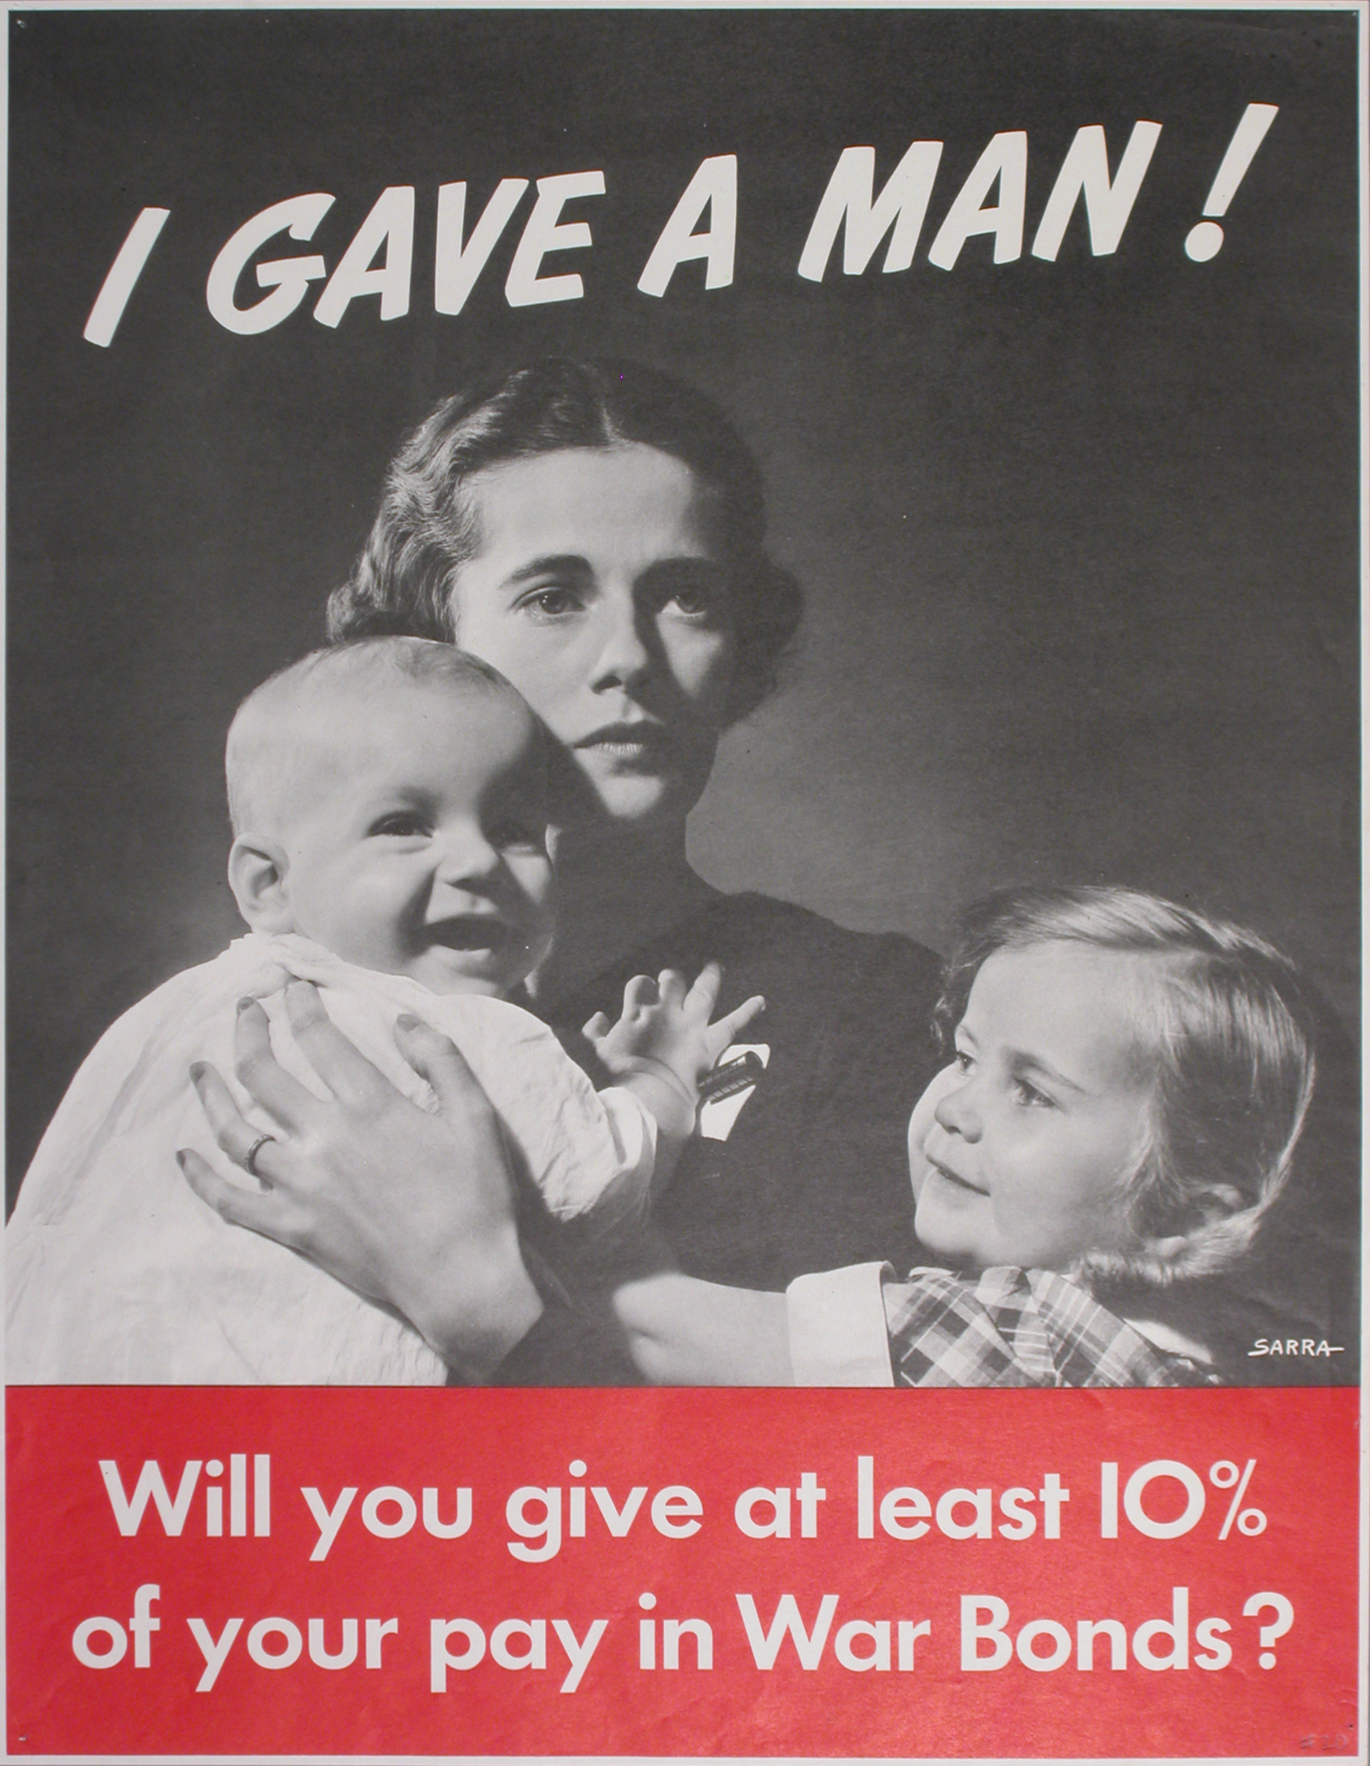
White Room (I) – Victory Gardens and Victory Bonds as a means of rationing on the Homefront
Victory bonds were investments available during the war, which people could invest on and receive interest for. Women in the Americas, having capably replaced men in the work force, could earn wages and invest in these to support their government, their country, and their loved ones through funding the war effort.
Victory gardens were home-based gardens tended by citizens on the home front. The ideal was that citizens could provide most if not all their vegetable needs by growing things themselves. The reason for this was to increase the food production during the war. By growing some of their own vegetables at home, women were hailed for the patriotic effort, among many other sacrifices, which demonstrated again how self-sufficient women could be. Also, since victory gardens produced some of their own vegetables at home, more of the produce from farmers could be given to soldiers overseas.
While rationing made it difficult to obtain scarce items like eggs, sugar, and butter, women circumvented the dreary effects of this on their cooking. They joined women’s clubs, and produced wartime cookbooks that used rations to make classic dishes that, while not to the same quality as with more scarce ingredients, still allowed for freedom in the kitchen and in feeding their children.
Other examples of rationing include excluding fashion items with nylon, rubber, and metal in them with the motto “Use it Up, Wear it Out, Make it Do, or Do Without.” Rubber and metal were useful for guns and tires for military vehicles.

Slide 12
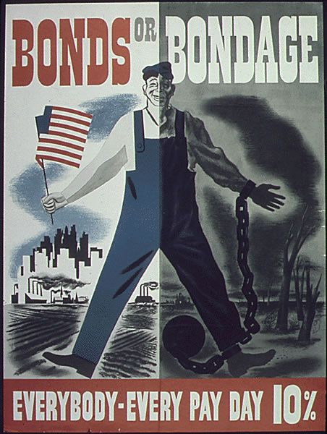
The Gold Room (J) - The Gift Shop
Miniature Do It Yourself Victory Garden
Rachael the Real factory worker – “Now it’s our turn!”
Photoshop your face onto a propaganda poster
Broach – “We Can Do It!”
Wartime rations recipe book

Slide 13
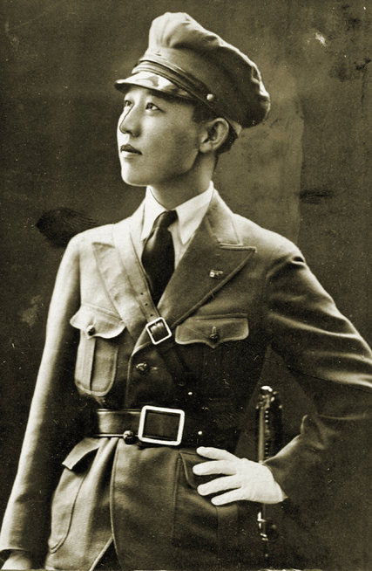
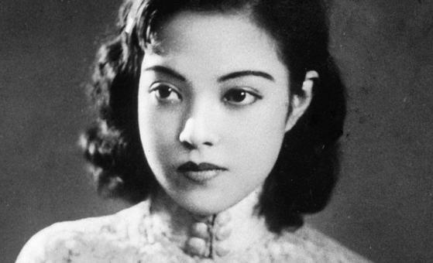
Silver Room (K) - Special Display: War Experience of Asian Women
Since Japan had already invaded China before WWII, Japanese government sent spies to China for espionage activities. Yoshiko Kawashima was a Chinese princess of Manchu descent. However, she was raised in Japan and took the political, intelligence, military training and worked for Japanese military as spy and she was executed for the crime of treason after Japan surrendered. In contrast, Yoshiko Yamaguchi, a famous singer and actor, who was also a Japanese born in China, serve for Japanese military as propagate tool but she was release after the war due to the nationality of Japan.

Slide 14
The End
☺

